Slide 1
Negative Feedback Dissected
Herbert M Sauro
University of Washington
Bioengineering

Slide 2
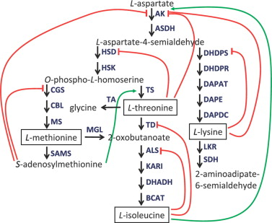
Negative Feedback
Amino Acid Biosynthesis:

Slide 3
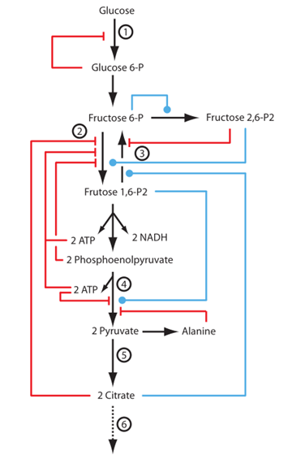
Negative Feedback
Glycolysis:

Slide 4
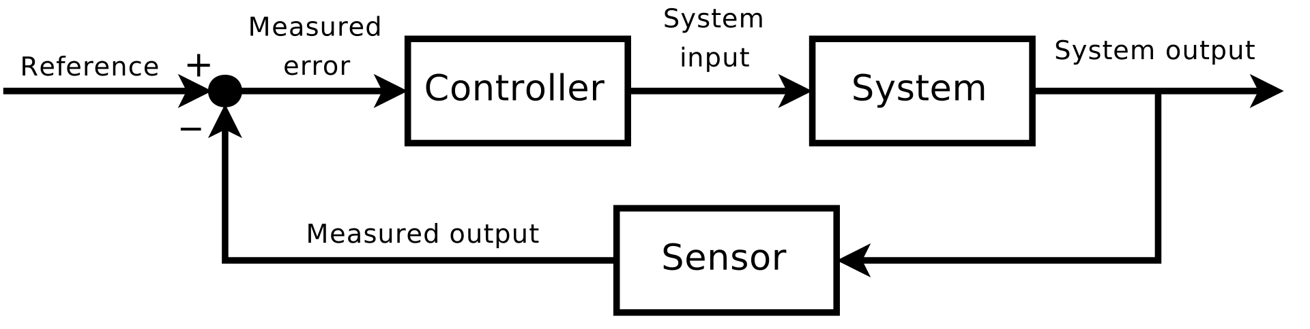
Classical Control Theory
The classical picture of control from
engineering control theory

Slide 5
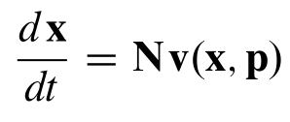
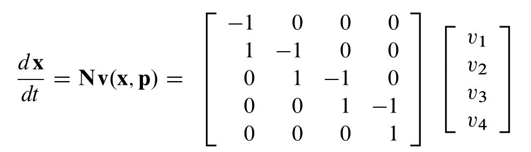
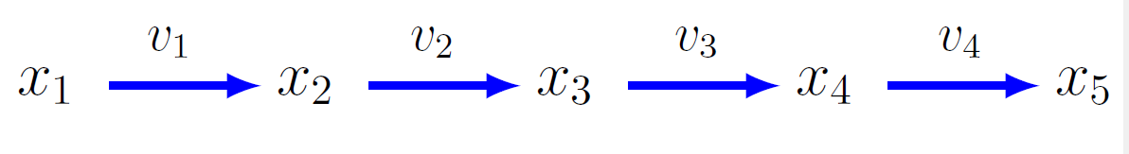
Control Theory of Biochemical Network
Stoichiometry,
Network Topology
Rate Vector

Slide 6
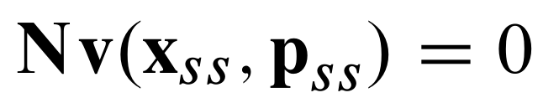
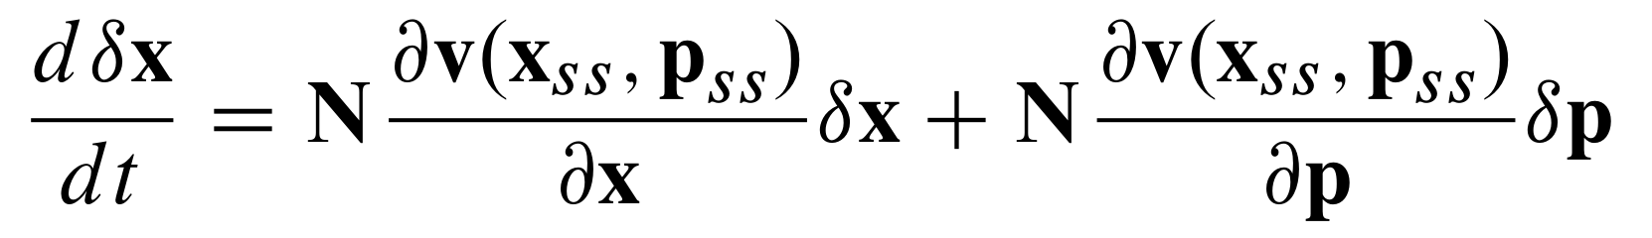
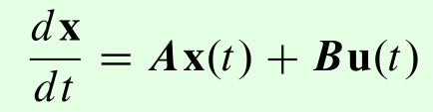
Control Theory of Biochemical Network
Linear Time Invariant System (LTI)
Move into the Laplace Domain:

Slide 7
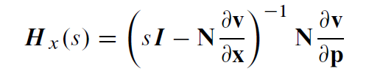


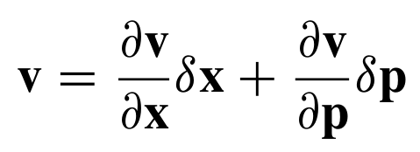
Linearize and Move into the Laplace Domain

Slide 8
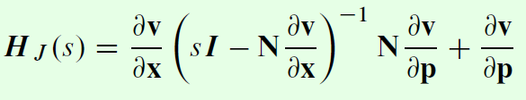
Linearize and Move into the Laplace Domain

Slide 9
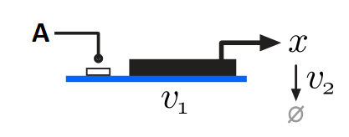
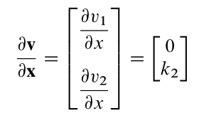
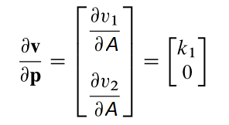

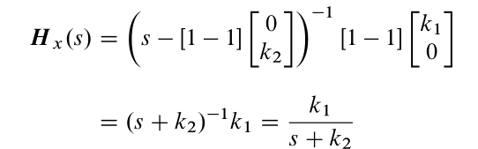
Example: Single Gene

Slide 10
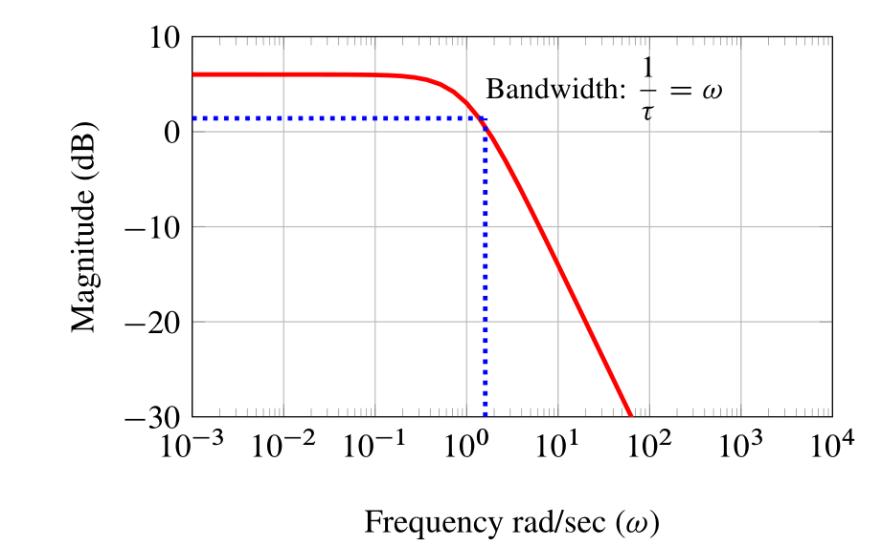
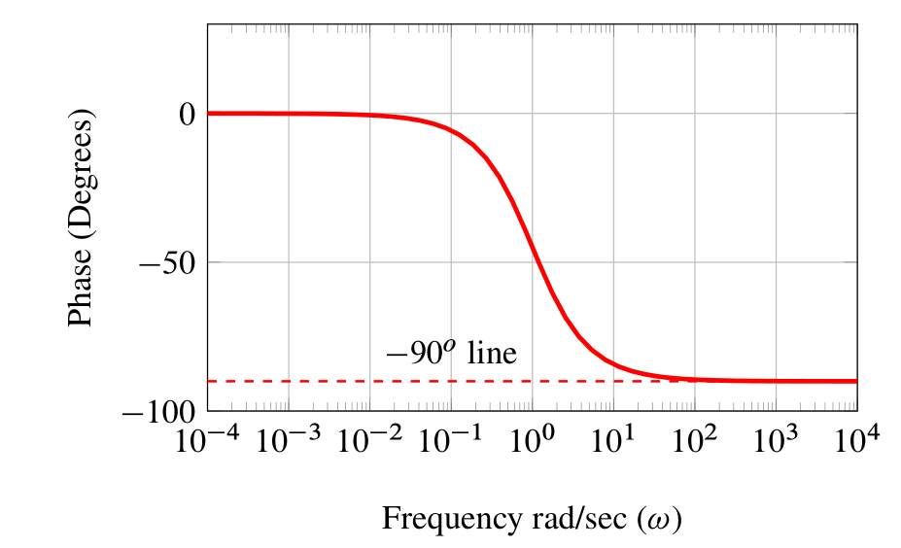
Single Gene: Frequency Response

Slide 11
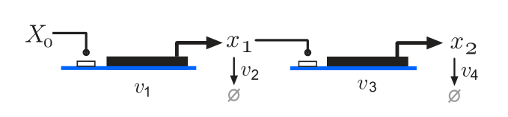
Example: Gene Cascade

Slide 12
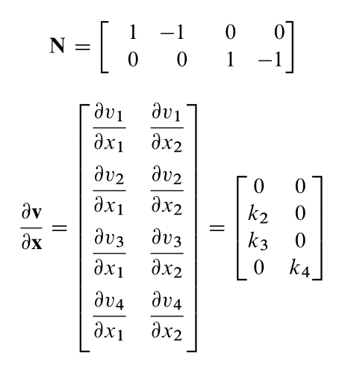
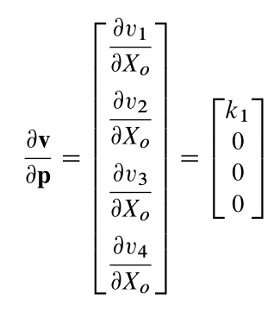
Gene cascade: Frequency Response

Slide 13
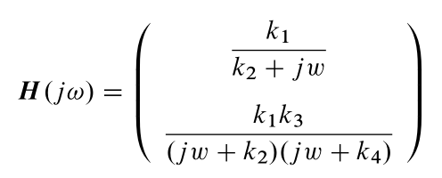


Single Gene: Frequency Response

Slide 14
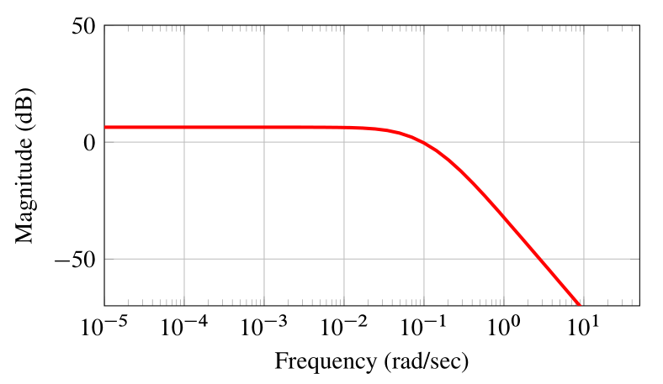
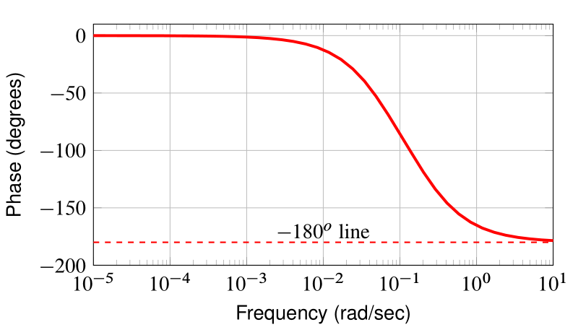
Bode Plots with respect to x2
Bode Plots with respect to $x_{2}$
Phase:

Slide 15
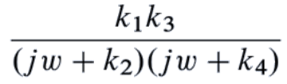


Gene cascade: Behavior

Slide 16

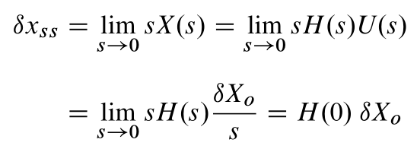
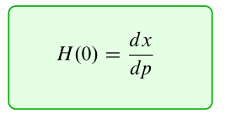

Frequency Response at H(0)
All changes are with respect to the steady state.
Using the final value theorem

Slide 17
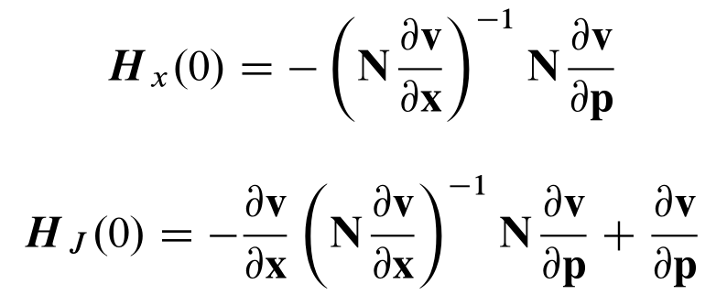
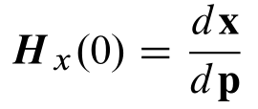
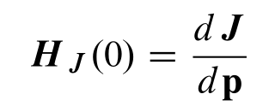
At Zero Frequency
Bode Plots Gene: Frequency Response

Slide 18
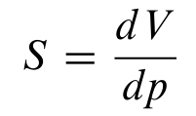
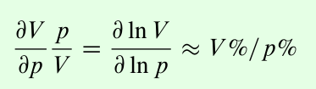
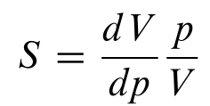
Scaled and Unscaled Sensitivities
Bode Plots Gene: Frequency Response

Slide 19
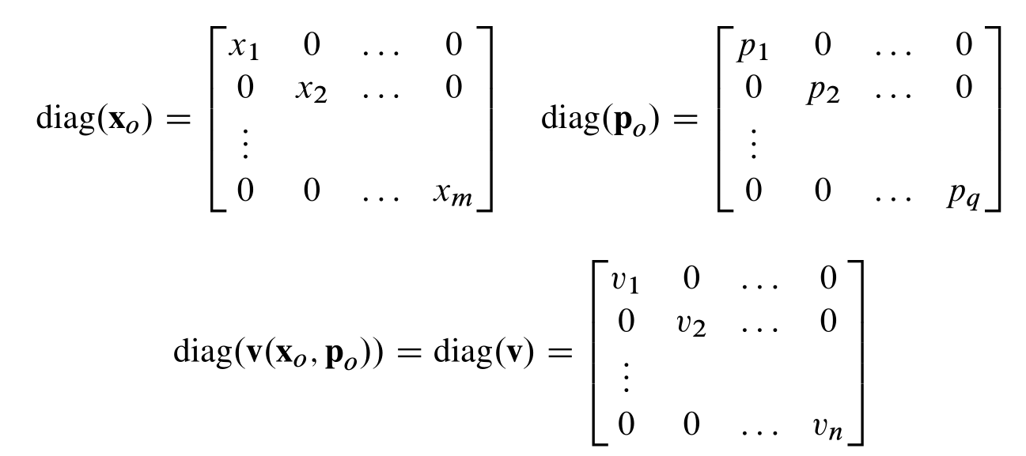
Scaled Transfer Function

Slide 20
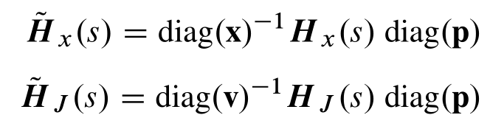
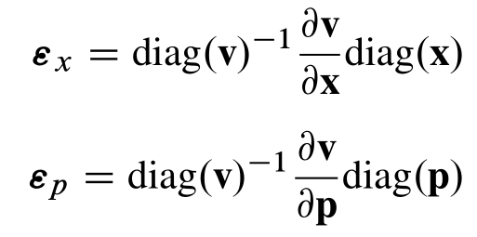
Scaled Transfer Function
Elasticities

Slide 21



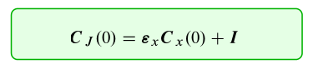
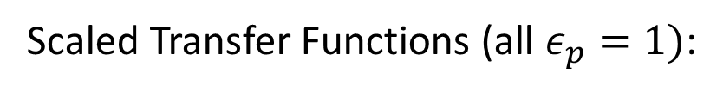
Scaled Transfer Functions:
Scaled Transfer Functions (all $ε_{p}=1)$:

Slide 22
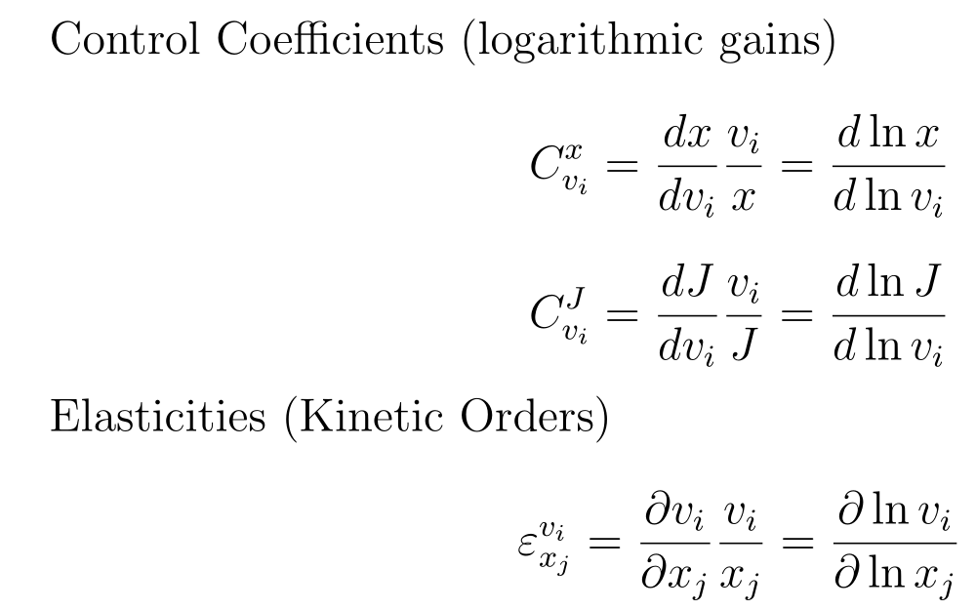
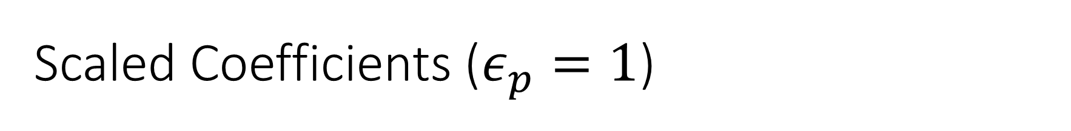
Scaled Coefficients ($ε_{p}=1$)

Slide 23
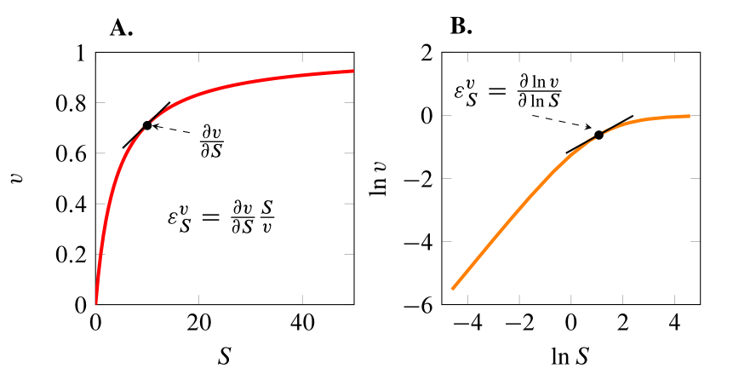
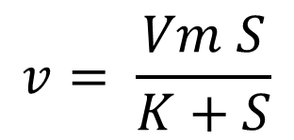
Elasticity Coefficients (Kinetic Orders)
$$v= \frac{Vm S}{K+S}$$

Slide 24

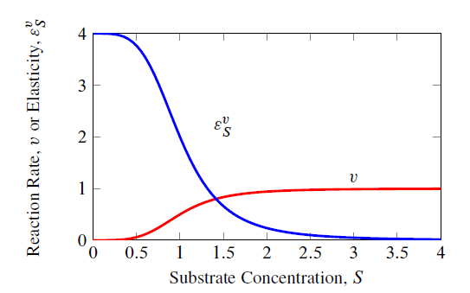

Hill Equation
n=4

Slide 25






Constraints on scaled coefficients:
=

Slide 26

Constraints on CJ:
=

Slide 27
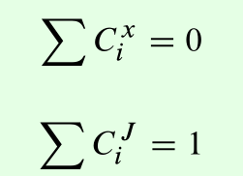
Constraints:

Slide 28
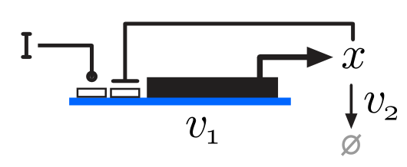
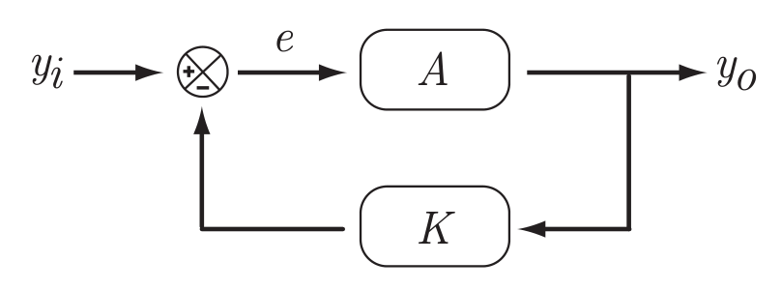
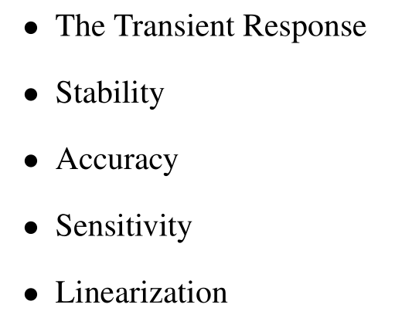
Negative Feedback
Classical Representation

Slide 29
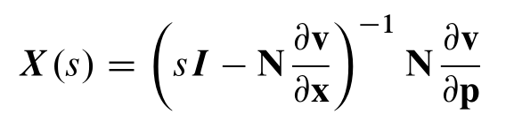
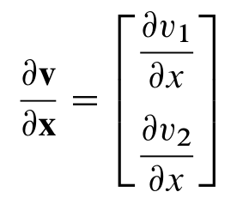
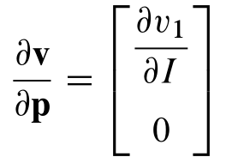

Negative Feedback

Slide 30

Negative Feedback
Loss of gain,
less sensitive
to changes in v1
Transient response is better because
change to x are influenced by both
V1 and v2.
x is less sensitive to change in v1 because
The feedback opposes and changes that
v1 can make.
Stability becomes and issue when there
Are genes in a cascade and even more
so with three genes in a cascade.
With negative feedback

Slide 31


Interpretation in terms of classical control

Slide 32




Interpreting in terms of classical control
Set Point =

Slide 33



Interpreting in terms of classical control
At steady state:

Slide 34




Interpreting in terms of classical control

Slide 35


Tracking of a Signal: Example

Slide 36

Tracking of a Signal
Feedback Strength

Slide 37






Negative Feedback
With feedback
Without feedback

Slide 38
Negative Feedback
With feedback
Without feedback

Slide 39


Effect of Negative Feedback
5000 simulations of a 4 step linear pathway. Randomizing
rate constants while keeping Keqs fixed.
Step 4
Frequency
Step 3
Step 1
Step 2
Front loading
Control Coefficient

Slide 40

Effect of Negative Feedback
5000 simulations of a 4 step linear pathway. Randomizing
rate constants while keeping Keqs fixed.
Step 1
Step 4
Frequency
Control Coefficient

Slide 41


Explanation for Front Loading

Slide 42





Explanation for Front Loading
$$v=k_{1}S −k_{2}P$$
The forward path has a higher gain than the reverse path, hence linear
pathways without negative feedback display front loading.

Slide 43


The Numerator of the Flux Transfer Function gives Information on the Signal Propagation Paths
Elementary Signal Modes

Slide 44

The Numerator of the Flux Transfer Function gives Information on the Signal Propagation Paths

Slide 45





Perturbation Paths through a signaling network

Slide 46
But many systems are stochastic?
Kim, Qian, and Sauro. Nonlinear Biochemical Signal Processing via Noise Propagation. Journal of Chemical Physics 139:144108 (2013)

Slide 47

Stochastic Focusing
Kim, Qian, and Sauro. Nonlinear Biochemical Signal Processing via Noise Propagation. Journal of Chemical Physics 139:144108 (2013)
Paulsson, et al. PNAS 97, 7148 (2000)

Slide 48



Simple Michaelis-Menten
$$\frac{x}{K+x}$$
Black = Deterministic solution
Elasticity plot

Slide 49


Simple Inhibition
$$\frac{1}{K+x^{1}}$$
Black = Deterministic solution
Elasticity plot
SD = Stochastic Defocusing; SF = Stochastic Focusing

Slide 50


Effect of SF on a Sigmoid Rate Law
$$\frac{x^{4}}{K+x^{4}}$$
Noise reduces the sigmoidicity

Slide 51


Acknowledgements
Brian Ingalls – Waterloo
Kyle Medley – Graduate at UW
Kyung Kim – UW, Bioengineering (Stochastic work)

Slide 52

We’re trying to understand this:

Slide 53
Let’s start with something simpler

Slide 54

Let’s start with something simpler
S
E
P

Slide 55
Add another step
S
E
S
E
S
1
1
2
2
3
And this is where things start going downhill rapidly

Slide 56
Add another step
S
E
S
E
S
1
1
2
2
3
Assuming S1 and S3 are fixed (at 0.5 mM and 0 mM) and steady state concentration of S2 = 0.25 mM and the Keq for each reaction is 1.5 and 0.75 respectively.
Q1. Which enzyme would be the best candidate to overexpress if
we wanted to maximize the flux?
Q2. If we can overexpress both enzymes what is the optimal relative
increase in E1 and E2 that maximizes the flux?
Q3. If we can overexpress both enzymes but the total E1+E2 is fixed what
is the optimal distribution in E1 and E2 that maximizes the flux?
PS You’re not allowed to run a computer simulation,
you may use a non-programmable calculator.

Slide 57
Add some more
S
E
S
E
S
E
S
1
1
2
2
3
3
4

